Slide 1
Advanced JavaScript
JS
Presented By : Asmaa Ahmed

Slide 2
Todo list in JavaScript
Key Concepts Used
OOP Principles:
Encapsulation with private fields (#tasks).
TaskManager class handles all logic.
AJAX:
Fetch API is used to load and save tasks (loadTasks, saveTasks).
Closures:
Button event handlers capture the taskManager instance.
Prototypes:
TaskManager methods (addTask, deleteTask, etc.) are shared via the prototype.

Slide 3
Steps Todo list in JavaScript
Tasks are fetched from tasks.json on page load.
Users can: Add tasks through the input form.
Mark tasks as completed/incomplete.
Delete tasks.
The UI updates dynamically after every action.
Tasks are saved back to the tasks.json file (simulated server).

Slide 4
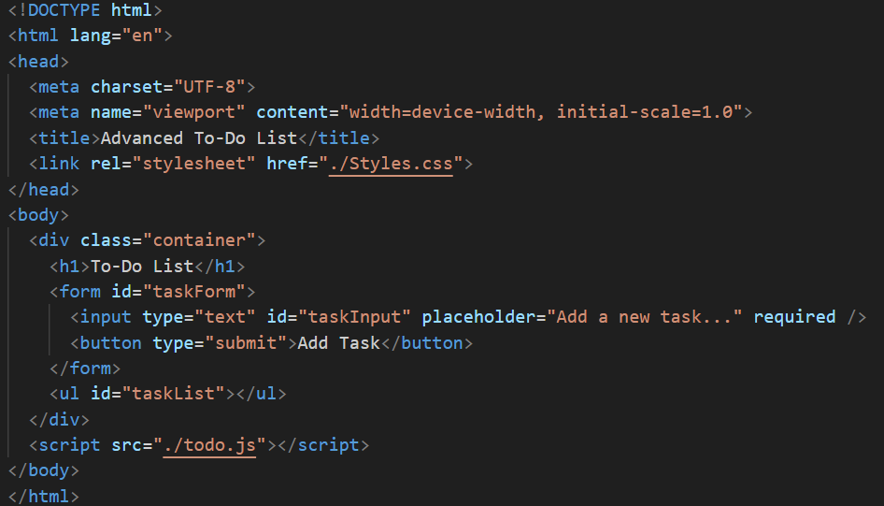
HTML File

Slide 5
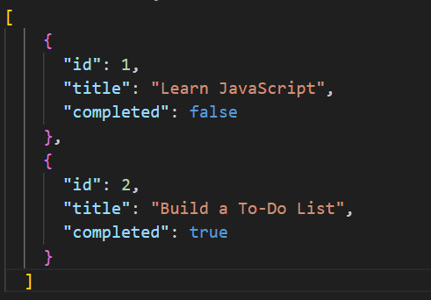
JSON File

Slide 6
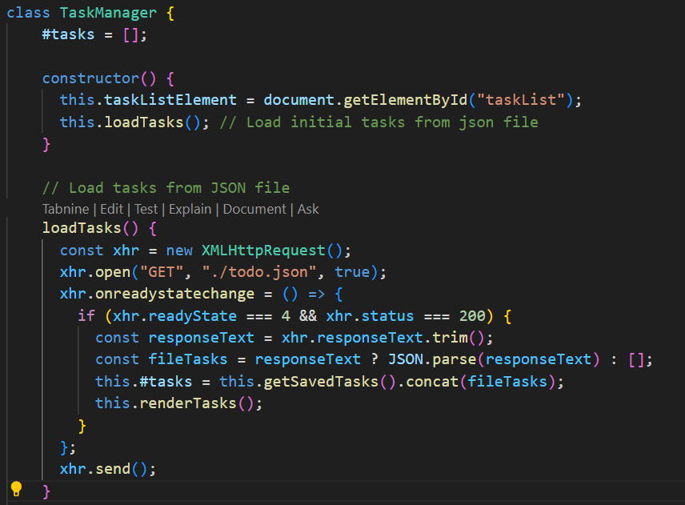
JS Code File

Slide 7
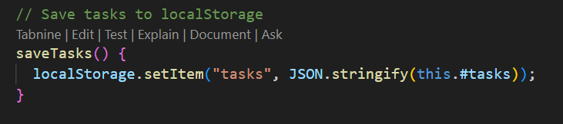
JS Code File

Slide 8
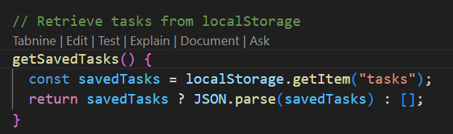
JS Code File

Slide 9
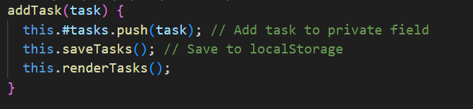
JS Code File

Slide 10
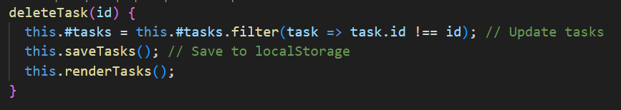
JS Code File

Slide 11
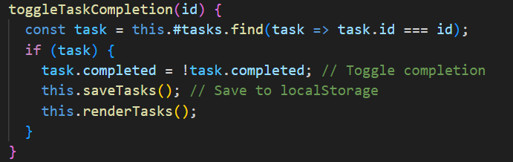
JS Code File

Slide 12
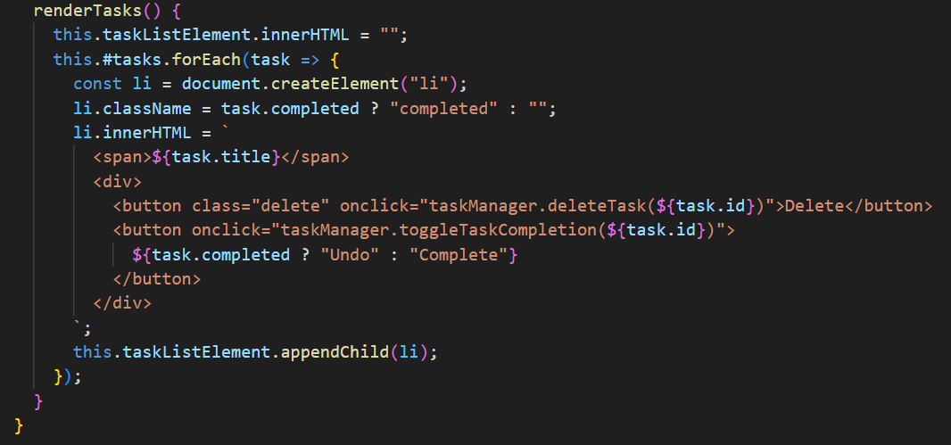
JS Code File

Slide 13

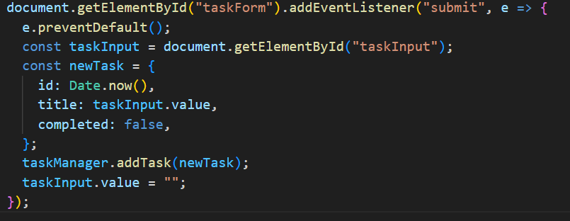
JS Code File

Slide 14
Steps Ballon Game in JavaScript
Start the Game:
Click the "Start Game" button to begin.
Balloons are generated every 800ms and float upwards.
Pop Balloons:
Click on balloons to pop them and score points.
If a balloon floats out of the game area, a penalty of -1 is applied to the score.
Game Timer:
The game lasts for 30 seconds.
The timer counts down, and the game ends when time reaches 0.
Game End:
A final score is displayed in an alert.
The player can restart the game by clicking "Start Game" again.

Slide 15
Features of Ballon Game in JavaScript
Balloons float upward with random horizontal positions.
Popping balloons increases the score.
Missing balloons decreases the score.
A countdown timer limits the game duration.
A "Start Game" button resets the game and starts a new session.

Slide 16
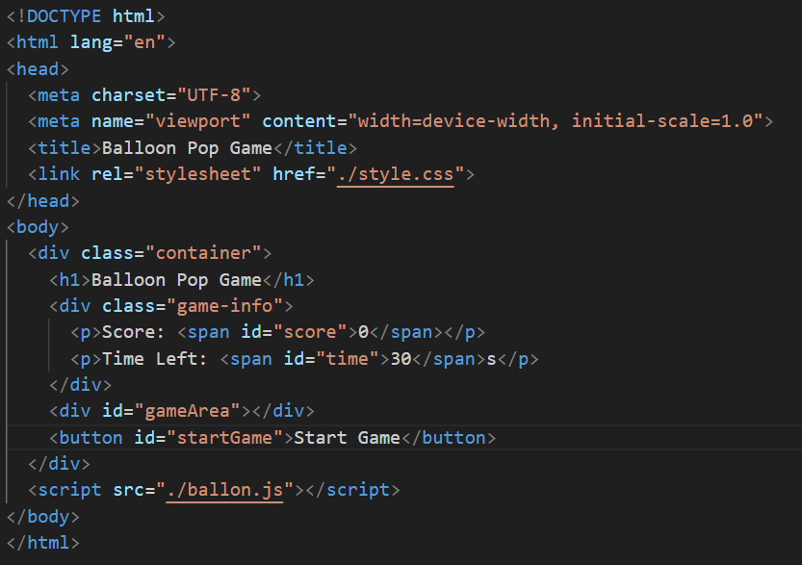
HTML File

Slide 17
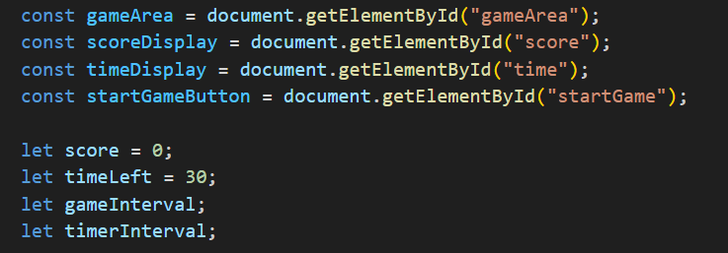
JS Code File

Slide 18
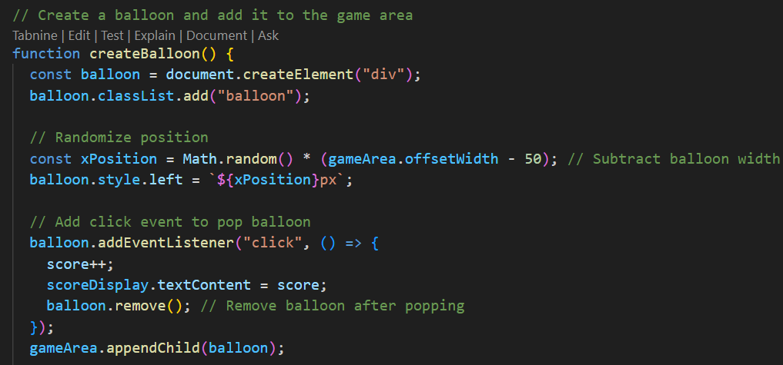
JS Code File

Slide 19
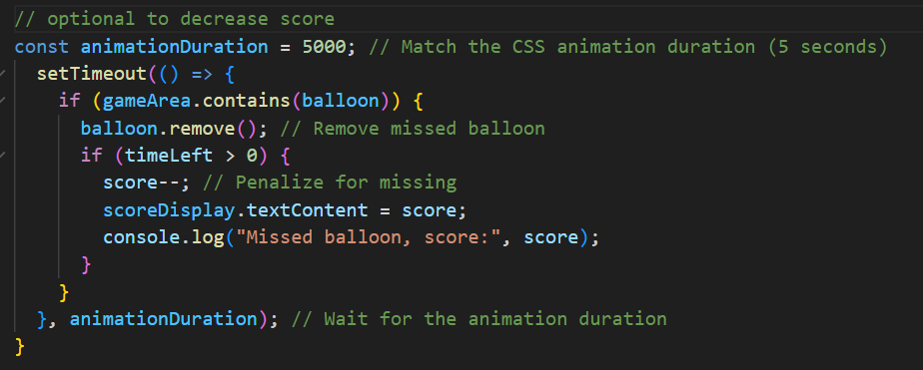
JS Code File Complete on createFunction

Slide 20
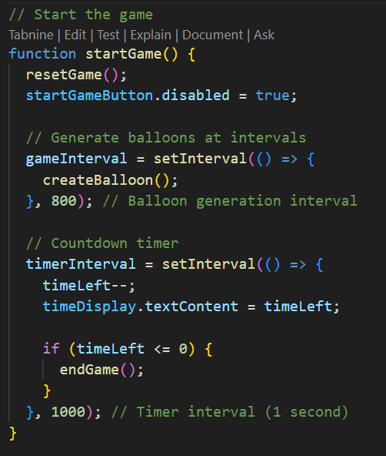
JS Code File

Slide 21
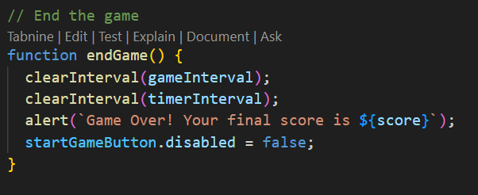
JS Code File

Slide 22
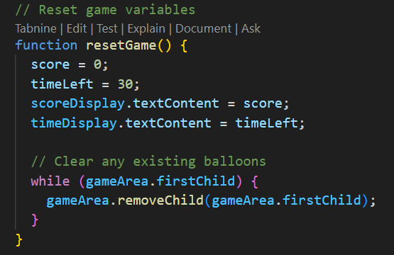
JS Code File

Slide 23

JS Code File

Slide 24
Thanks!
Do you have any questions?
asmaaahmed23762@gmail.com

